Slide 1


GAL Pals:
Guardians ad litem in the Brave New World of 2026
February 5, 2026

Slide 2

What are we talking about today ?
Your ‘pal’ for effectuating justice… a GAL !
What is a Guardian ad litem (GAL) ?
What, how, and why ?
AB 1279 (2022) eff. 2023
and
Conflicts of Interest
AB 565 (2025) eff. 2026
and
Virtual Representation

Slide 3
GUARDIAN AD LITEM (GAL)
Important Terminology
  Guardian ad litem (GAL)
  Ward
The appointed representative.
“Representative”
The person being represented.
“Represented Person/Party”

Slide 4

GUARDIAN AD LITEM (GAL)
So many questions…
What is a GAL?
For whom would a GAL be appointed?
What does the GAL do?
Is a GAL a Guardian or Conservator?
Why is court approval required?

Slide 5
GUARDIAN AD LITEM (GAL)
A guardian ad litem (GAL) is a person appointed by the court to represent the interests of someone else who cannot represent themselves in a legal proceeding.
Ad litem = Latin phrase for “to/for the dispute” (meaning “for the lawsuit” or “for the purposes of the legal action”)

Slide 6

GUARDIAN AD LITEM (GAL)
For whom would a GAL be appointed?
A minor;
An individual who lacks the legal capacity to represent themselves in legal proceedings;
An unknown class of persons;
An unborn or unascertainable person or class of persons;
Any person not adequately represented…

Slide 7
GUARDIAN AD LITEM (GAL)
What does the GAL do?
The guardian ad litem (GAL) acts as the representative of record and an officer of the court, with duties that include:
protecting the rights of the represented person(s),
controlling the litigation, and
making decisions in the best interests of the represented party,
But subject to court approval.

Slide 8

GUARDIAN AD LITEM (GAL)
Isn’t this what a Conservator or Guardian does?
The role of a Guardian ad litem (GAL)is different and distinct from that of a general [i.e., general purpose] Guardian (for minor(s)) or Conservator (for adult(s)), because the appointment of a GAL is specifically limited to representing the interests of the represented person in the civil action (lawsuit), special proceeding, or other legal proceeding in which the GAL has been appointed.

Slide 9

GUARDIAN AD LITEM (GAL)
Court supervision and approval
The Guardian ad litem (GAL) is appointed by the Court only for purposes of pending litigation. The rule of a GAL is solely to protect and defend the ward's interest in that action, suit, or proceeding. In so doing, the GAL’s role is that of a court-appointed officer, who, under the appointment of and under the supervision of the trial court, must act in the ward’s best interests.
See McClintock v. West (2013) 219 Cal.App.4th 540; J.W. v. Superior Court (1993) 17 Cal.App.4th 958
The trial court has the duty to ensure the ward’s rights are protected by the GAL.
See Berry v. Chaplin (1946) 74 Cal.App.2d 652
In an adversarial proceeding, the GAL’s function is to protect the rights of the ward by controlling the litigation and the procedural steps incident to the conduct of the litigation, including compromise or settlement.
See In re Christina B. (1993) 19 Cal.App.4th 1441

Slide 10





GUARDIAN AD LITEM (GAL)
When dealing with:
Minor(s);
Unknown person(s);
Unborn or Unascertained person(s); and/or
Incapacitated persons(s)…
Who is your ‘pal’?

Slide 11

GUARDIAN AD LITEM (GAL)
A court-appointed Guardian ad litem (GAL) is your ‘pal’ to effectuate justice.

Slide 12




GUARDIAN AD LITEM (GAL)
But…for many people, the appointment of a GAL implies:
  Problems
  Delay
  Expense

Slide 13

GUARDIAN AD LITEM (GAL)
California’s
GAL statutes

Slide 14
CIVIL – CCP §§372 et seq.
CCP §372 provided that when a minor, a person who lacks legal capacity to make decisions, or a person for whom a conservator has been appointed, is a party to a civil proceeding, then that party “shall appear” either by appointed guardian or conservator, or by a “guardian ad litem[GAL] appointed by the court in which the action or proceeding is pending.”
CCP §373(c) provided for the appointment of a GAL “by the court on its own motion” where the evidence supports the finding that an adult party to the action lacks legal competence to make decisions.

Slide 15
PROBATE – Prob. Code §1003
Prob. Code §1003 provided for the appointment of a GAL “by the court on its own motion” at any stage of a proceeding under the Probate Code to represent the interest of any of the following persons, if the court determines that representation of the interest otherwise would be inadequate:
  A minor.
  A person who lacks legal capacity to make decisions.
  An unborn beneficiary.
  An unascertained person.
  A person whose identity or address is unknown.
  A designated class of persons who are not ascertained or are not in being.

Slide 16

Senate Bill No. 1279 (SB 1279) (2022)
What do we need to know?
General statutory enactment of the “conflict of interest” standard as to appointment of GALs
Revisions to CCP §372 et seq. (CIVIL)
Revisions to Prob. Code §1003 (PROBATE)
Enacted 2022; effective January 1, 2023

Slide 17
What Used To Be…
Prior to SB 1279, there was sparse authority for determining who to appoint as a guardian ad litem (GAL) and exactly what would be a situation or conflict of interest to disqualify the person from being a GAL. Examples:
In determining whether to appoint a particular person as GAL, the trial court is required to consider whether the GAL and the ward (minor or person who lacks legal capacity to make decisions) have “divergent interests.” CCP §§372(b)(1) & 374.
  To the extent that someone with “divergent interests” could not be originally appointed as a GAL, then, presumably, a person so appointed who suffers from such divergent interests should correspondingly be disqualified from continuing to serve as GAL.
Interesting - the only place where “conflict of interest” was explicitly stated was in connection with multiple representations. Hence, a GAL might be appointed to represent several persons or interests as wards, so long as there are no conflicts of interests as between such persons or interests. Prob. Code §1003(b).

Slide 18
What Used To Be…
But the case law provided some additional directions:
Estate of Lacy (1975) 54 Cal.App.3d 172 (is improper to appoint as a GAL one who, however well-intentioned, is in an adverse position to the ward)
People v. Superior Court (Humberto S.) (2008) 43 Cal.4th 737 (conflicts of interest may in some instances disqualify parents from waiving or asserting privileges on behalf of their minor children and in other instances support the appointment of an independent person as GAL)
Williams v. Superior Court (2007) 147 Cal.App.4th 36 (father who was separated from mother had impermissible conflict of interest with children in connection with mother’s wrongful death action)

Slide 19

What Used To Be…
And what about analogous standards for other court-appointed fiduciaries:
Example: An appointed conservator or guardian may be removed for having such an interest adverse to the faithful performance of duties that there is an unreasonable risk that such a person will fail to perform their duties faithfully.
  Prob. Code §2650(f).
    See Estate of Howard (1955) 133 Cal.App.2d 535
    See Guardianship of Leach (1947) 30 Cal.2d 297
  Is that really a ‘conflict of interest’ standard? Maybe, may be not…one could argue and the language afforded flexibility…

Slide 20

What Used To Be…
So, prior to SB 1279, a person would be disqualified as a GAL and could not be appointed to such a position if he or she was adverse to, or had “divergent interests” with respect to, the ward…whether that equated to an actual conflict of interest, or not.
Now comes SB 1279…

Slide 21
What it is Now…
After SB 1279: A person is disqualified as a GAL and cannot be appointed to such a position if he or she has a “conflict of interest.”
  Changes made to both:
    CCP §§372 et seq. [CIVIL]; and
    Prob. Code §1003 [PROBATE]

Slide 22
What it is Now…
After SB 1279: The “divergent interests” language remains in revised and reorganized CCP §372, but we have new additions:
  (d) Before a court appoints a guardian ad litem pursuant to this chapter, a proposed guardian ad litem shall disclose both of the following to the court and all parties to the action or proceeding:
    (1) Any known actual or potential conflicts of interest that would or might arise from the appointment.
    (2) Any familial or affiliate relationship the proposed guardian ad litem has with any of the parties.
  (e) If a guardian ad litem becomes aware that a potential conflict of interest has become an actual conflict of interest or that a new potential or actual conflict of interest exists, the guardian ad litem shall promptly disclose the conflict of interest to the court.

Slide 23
What it is Now…
After SB 1279:
Revised Prob. Code §1003 (PROBATE) – new addition to statute:
  (e) If a guardian ad litem becomes aware that a potential conflict of interest has become an actual conflict of interest or that a new potential or actual conflict of interest exists, the guardian ad litem shall promptly disclose the conflict of interest to the court.

Slide 24
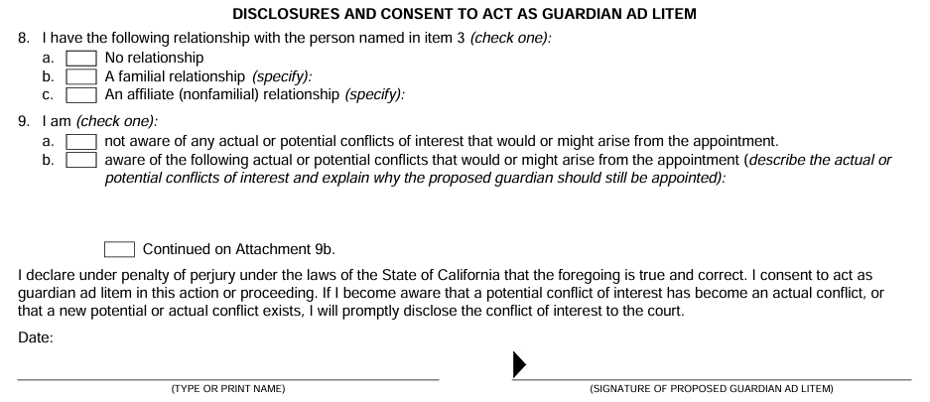


CIVIL – After SB 1279
Must disclose any known actual or potential conflicts of interest in revised, mandatory Judicial Council form CIV-010/FL-395:
Under penalty of perjury

Slide 25
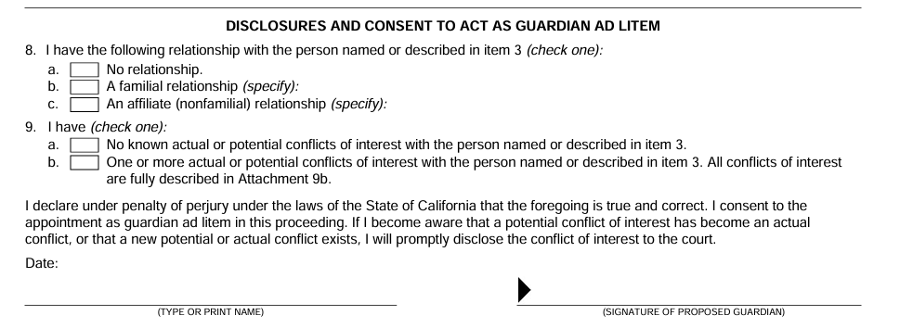
PROBATE – After SB 1279
Must disclose any known actual or potential conflicts of interest in revised, mandatory Judicial Council form DE-350/GC-100:
Under penalty of perjury

Slide 26

After SB 1279…the Unknown
So why is the “Disclosure and Consent to Act” language in the new mandatory Judicial Council forms CIV-010/FL-395 (CIVIL) and DE-350/GC-100 (PROBATE) different?
Hint: this form language about conflicts of interest existed prior to SB 1279, even though it was not required by the then-existing statute.

Slide 27

Assembly Bill No. 565 (AB 565) (2025)
What do we need to know?
The Doctrine of Virtual Representation
Replaces text of Probate Code §15804
Affects the giving of notice
  But in trust proceedings only
  No effect on other proceedings arising under the Probate Code
Enacted 2025; effective January 1, 2026

Slide 28
Doctrine of Virtual Representation
The issue:
In trust and estate administration matters, it is often crucial to bind all interested persons to certain actions or settlements.
Sometimes we are merely giving notice, not engaged in actual court proceedings.
Nevertheless, those persons may be:
  Difficult to identify and/or find; or
  They may be under a legal disability
HINT:
The types of persons
for whom a GAL
might be appointed…

Slide 29
Doctrine of Virtual Representation
The common law doctrine of virtual representation:
The doctrine provides a mechanism to seek to bind non-participating person(s) under a legal disability.
And to do so without the problems, expense, and delay of a court-appointed representative, such as a guardian ad litem (GAL).

Slide 30
Doctrine of Virtual Representation
Statutory enactments:
The majority of states have a codified virtual representation statute for judicial and non-judicial matters.
  Many of those states have adopted some form of the Uniform Trust Code (UTC).
  Others have also adopted non-uniform statutes, such as California.
Although the provisions of the statutes vary, the concept remains the same…allowing one person to step in and bind someone else without the need for the appointment of a guardian, conservator, personal representative, or guardian ad litem (GAL).

Slide 31
Doctrine of Virtual Representation
HOWEVER:
In most states, these virtual representative statutes apply to only to trust proceedings.
    See, for example, UTC §301
In some states, virtual representation may also be used to bind parties in non-trust proceedings, i.e., estate matters.
    See N.Y. Surrogate’s Court Procedure Act (SCPA) §315.

Slide 32
Doctrine of Virtual Representation
CONFLICTS OF INTEREST:
In most instances, for purposes of these statutory enactments, an individual may not represent another individual if there is a conflict of interest between the parties regarding the particular subject(s) or dispute(s) at issue in the proceeding.
    See, for example, UTC §§303, 304
We have seen this concept before!!!

Slide 33
Doctrine of Virtual Representation
Discretionary appointments:
And, in most instances, these virtual representation statutory enactments still provide that a court, in its discretion, may appoint a person as the representative of a person not otherwise adequately represented in the proceeding.
    See, for example, UTC §305

Slide 34


Assembly Bill No. 565 (AB 565) (2025)
Purpose of AB 565:
Replaces the entirety of the text of Prob. Code §15804, which governs the giving of notices to persons interested in a trust.
Existing statutory text was generally described as confusing and archaic, often unnecessarily requiring appointment of a GAL.

Slide 35
Assembly Bill No. 565 (AB 565) (2025)
Purpose of AB 565:
Allows for broad virtual representation, in trust matters, to permit an individual’s interest to be adequately represented by another with a substantially similar interest.
Without necessarily the need for the appointment of a GAL.

Slide 36
The new Prob. Code §15804
Prob. Code §15804(a):
Notice to a person who may represent and bind another person pursuant to this section is sufficient to comply with a requirement in this division that notice be given to the represented person, and has the same effect as if notice were given directly to that represented person.
This is about notice

Slide 37
The new Prob. Code §15804
Prob. Code §15804(b):
A person may serve as a representative and bind another person, except as follows:
  (1) The representative and the represented person shall not have a conflict of interest during the representation with respect to the particular matter that is the subject of the representation.
  (2) A settlor shall not represent and bind a beneficiary regarding the termination or modification of an irrevocable trust.
Except…

Slide 38
The new Prob. Code §15804
Prob. Code §15804(c):
Let’s SKIP this for a moment…
We will come back to this subsection later.
More on this later…

Slide 39
The new Prob. Code §15804
Prob. Code §15804(d):
  An action taken by the court under this division is conclusive and binding upon a person represented pursuant to this section.
Binding Effect

Slide 40
The new Prob. Code §15804
Prob. Code §15804(e):
  The following representation is permissible:
  (1) A parent (#) may represent and bind the parent’s minor children and children subsequently born if a guardian or guardian ad litem for the child or children has not been appointed.
  (2) A conservator (*) of the estate may represent and bind the conservatee.
  (3) A guardian (*) of the estate may represent and bind the minor ward.
  (4) A guardian ad litem (*) with authority to act with respect to the matter may represent and bind the ward.
  (5) An agent (*) with authority to act with respect to the matter may represent and bind the principal.
  (6) A trustee (*) may represent and bind the beneficiaries of the trust.
  (7) A personal representative (*) may represent and bind persons interested in the estate.
Examples
(#) Parents – BLUE (*) Fiduciaries - RED

Slide 41
The new Prob. Code §15804
Interesting note regarding Prob. Code §15804(e):
  From the legislative history, this language was stricken from the final approved text:
  The following representation is permissible , but the parent or fiduciary shall act in accordance with their duties:

Slide 42
The new Prob. Code §15804
Prob. Code §15804(f):
  Unless otherwise represented, a minor, an incapacitated person, a person subsequently born, or a person whose identity or location is unknown and not reasonably ascertainable may be represented by and bound by another person having a substantially identical interest with respect to the particular question or dispute.
The Classics

Slide 43
The new Prob. Code §15804
Prob. Code §15804(g):
  The following representation of successive interests is permissible:
  (1) If an interest has been given to persons who comprise a certain class upon the happening of a future event, the living persons who would constitute the class as of the date the representation is to be determined may represent and bind all other members of the class as of that date.
  (2) If an interest has been given to a living person or to a class of persons, and a substantially identical interest is to pass to another person or class of persons, or both, upon the happening of a future event, the living person or the living members of the class of persons who hold the interest may represent and bind all of the persons and classes of persons who might take on the happening of all future events.
  (3) If an interest will be given to a living person or to a class of persons upon the happening of a future event and a substantially identical interest would pass to another person or class of persons, or both, upon the happening of one or more future events, the living person or the living members of the class of persons who will hold the interest on the happening of an earlier event may represent and bind all of the persons and classes of persons who might take on the happening of all future events.
Successive Interests

Slide 44
The new Prob. Code §15804
Prob. Code §15804(h):
  The holder of a lifetime or testamentary power of appointment may represent and bind persons who are permissible appointees or takers in default of that exercise.
Power of Appointment

Slide 45
The new Prob. Code §15804
Prob. Code §15804(i):
  This section does not affect either of the following:
  (1) Requirements for notice in a court proceeding to any of the following:
    (A) A person who has requested special notice.
    (B) A person who has filed notice of appearance.
    (C) A particular person or entity required by statute to be given notice.
  (2) Availability of a guardian ad litem pursuant to Section 1003.
But…

Slide 46
The new Prob. Code §15804
(back to…) Prob. Code §15804(c):
  [As to any other person, the following:]
  (1) A person shall provide consent in writing for another person to represent and bind them.
  (2) The consent of a person who may represent and bind another person pursuant to this section is binding on the represented person unless the represented person objects to the representation before the consent would have become effective.
  (3) A fiduciary who acts in reliance upon a representation made pursuant to this section shall not be liable for any resulting loss, unless the fiduciary committed a breach of trust intentionally, with gross negligence, in bad faith, or with reckless indifference to the interests of a beneficiary.
Consent

Slide 47
GUARDIAN AD LITEM (GAL) AFTER AB 565
Key Take-Aways:
Prob. Code §5804 deals only with notice in a trust proceeding, seeking ways to avoid the unnecessary need for the appointment of a GAL simply to comply with a requirement to provide notice to another person (i.e., due process).
A person may not serve as a representative pursuant to new Prob. Code §15804 if there is a conflict of interest during the representation with respect to the particular matter that is the subject of the representation [see 15804(b)(1)].
If the issue is not merely the giving of notice in a trust proceeding, but representation or participation in a court proceeding, then a GAL might still be required even if virtual representation under Prob. Code §15804 would be sufficient notice.

Slide 48
PRACTICAL GUIDANCE
When in doubt if there exists a disqualifying conflict or divergence of interests,
or
When in doubt if a substantial similarity of interests exists,
or
If the circumstances warrant a definitive assurance of validity and finality,
or
If merely giving notice would not be sufficient,
Then the recommended best practice is to continue to
seek and obtain the appointment of
an independent Guardian ad litem (GAL).

Slide 49
Thank you.
GAL Pals:
Guardians ad litem in the Brave New World of 2026
Adam L. Streltzer, Esq.
Los Angeles & Culver City, CA
(424) 652-8010 telephone
(424) 652-2296 fax
www.streltzer.com
adam@streltzer.com

