Slide 1


Woodland Hills
Tax & Estate Planning Council
Wednesday, October 6, 2021
Speakers:
Mitch Rosenberg, CFP®, CLU®, MSFS, AEP®, CEPA®
Melissa Winn, J.D., LL.M Corporate Vice President and Advanced Planning Consultant for New York Life Insurance Company
“Managing Retirement Plan Distributions in a Changing Environment – Why it is essential for Advisors and their Clients to Review and Rethink their Distribution and Legacy Strategies.”

Slide 2
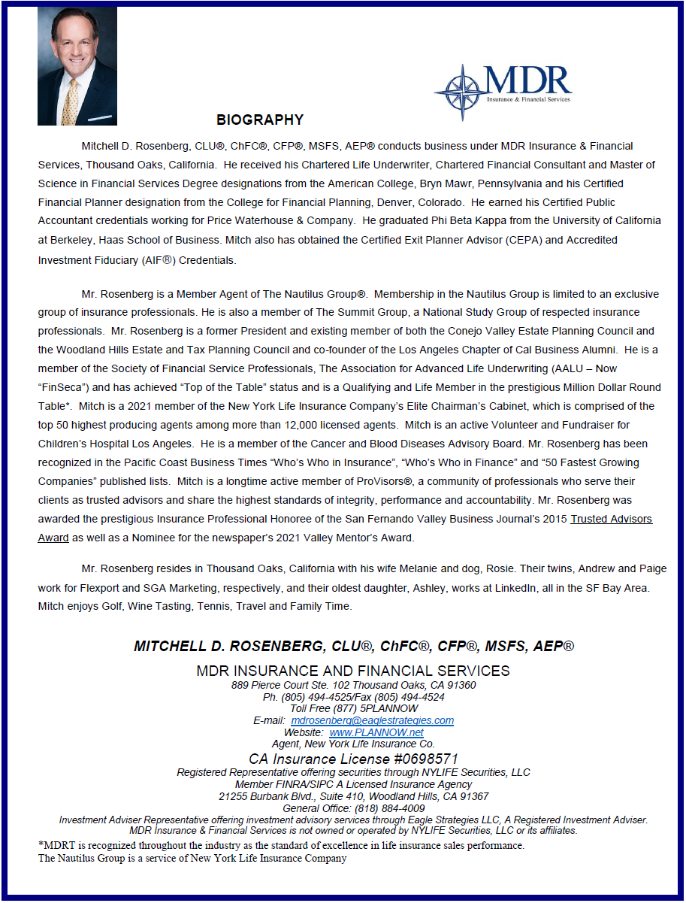


Slide 3
The SECURE ACT and the Charitable Remainder Trust - A Deep Dive
Leimberg Information Services
Professor Christopher Hoyt, JD, UMKC School of Law
Robert S. Keebler, CPA/PFS, MST, AEP

Slide 4

Outline
Lifetime Distributions – Changes for 2020 and 2021
Planning for Inherited Retirement Accounts
Secure Act – Ten Year Rule
Secure Act Exceptions
Charitable Planning with IRAs
IRAs Payable to CRT

Slide 5
REQUIRED MINIMUM DISTRIBUTIONS
*LIFETIME DISTRIBUTIONS*
TWO CHANGES FOR LIFETIME RMDs:
1. New RMD Age : 72
(for people who attain age 70 ½ after 2019)
(Despite new age 72, charitable QCD still 70 ½)
2. New life expectancy tables (beginning in 2021)
Annual RMD amounts will decline by
between 0.3% and 0.5% each year (varies by age)

Slide 6
Want to make charitable gifts from your IRA (“QCD”)?
Then NEVER make a tax-deductible contribution to your IRA after attaining age 70 ½
SECURE Act: If a person ever makes a tax-deductible contribution to an IRA after age 70 ½, then the amount of the qualified charitable distribution from an IRA that can be excluded from taxable income is reduced by that amount.
(New last sentence added to end of Sec 408(d)(8)(A))
.

Slide 7

Secure Act: 10 Year Rule
The SECURE Act basically, requires all IRAs, Roth IRAs, and Qualified Plans to be distributed within 10-years of death.

Slide 8

Secure Act: 10 Year Rule
Post-Death Distributions after the Secure Act:
  Non-Designated Beneficiaries
    Five-Year Rule
    “Ghost” Rule
    Guidance Needed from IRS or Treasury
  Designated Beneficiaries
    Ten-Year Rule
  Eligible Designated Beneficiaries
    Spouses – Life Expectancy
    Minor Children – Life Expectancy (modified)
    Disabled Beneficiaries – Life Expectancy
    Chronically ill Beneficiaries – Life Expectancy
    Individual not more than ten years younger than employee
IRC § 401(a)(9)

Slide 9
Responding to the “Ten-Year Rule”
Prior Law Compared to the “Ten-Year Rule”
Beneficiary Options after the Secure Act
Conduit v. Accumulation Trusts after the Secure Act
Solutions to Analyze which may Reduce the Impact of the 10-Year Rule:
  Multi-generational Spray Trusts
  Roth Conversions
  Spousal Rollovers and the New Spousal Rollover Trap
  IRAs Payable to CRTs
  IRA Trusts for State Income Tax Savings
  Life Insurance Solutions
  Qualified Charitable Contributions
  Naming a Charity as a Beneficiary

Slide 10
Secure Act Exceptions

Slide 11

Secure Act: 10 Year Rule
Eligible Designated Beneficiaries
Minor Child
  As described in IRC §409(a)(9)(F) and in the attendant regulations, a child may be treated as having not reached majority if they have not completed a “specified course of education” and is under the age of 26.
  If both of the requirements are met, the minor child beneficiary may use the Life Expectancy until 26 years of age.

Slide 12
Secure Act: 10 Year Rule
Eligible Designated Beneficiaries
Disabled Persons
  As described in IRC §72(m)(7), “an individual shall be considered to be disabled if they are unable to engage in any substantial gainful activity by reason of any medically determinable physical or mental impairment which can be expected to result in death or to be of long-continued and indefinite duration.”
  An individual must provide proof of their disability.
  If an individual is deemed disabled, they are allowed to use the Life Expectancy rule.

Slide 13
Secure Act: 10 Year Rule
Eligible Designated Beneficiaries
Chronically Ill
  As described in IRC §7702B(c)(2), a “chronically ill individual” means an individual who has been certified by a licensed health care practitioner as:
    Being unable to perform at least two activities of daily living for a period of at least 90 days due to loss of functional capacity,
    Having a level of disability that is to the level of the bullet point described above, or
    Requiring substantial supervision to protect such individual from threats to health and safety due to cognitive impairment.
  If an individual is deemed chronically ill, they are allowed to use the Life Expectancy rule.

Slide 14
Responding to the 10 Year Rule
Prior Law Compared to the “Ten-Year Rule”
Beneficiary Options after the Secure Act
Conduit v. Accumulation Trusts after the Secure Act
Solutions to Analyze which may Reduce the Impact of the 10-Year Rule:
  Multi-generational Spray Trusts
  Roth Conversions
  Spousal Rollovers and the New Spousal Rollover Trap
  IRAs Payable to CRTs
  IRA Trusts for State Income Tax Savings
  Life Insurance Solutions
  Qualified Charitable Contributions
  Naming a Charity as a Beneficiary

Slide 15

Solutions – Key Concepts
Retain Income Tax Deferral
Bracket Management within a Family
Fulfill Charitable Goals with IRD
“Convert” Ordinary Income to Capital Gain
Manage State Income Taxes

Slide 16
Secure Act Beneficiary RMD Summary
Tax Terminology | Designated Non-Eligible Beneficiary | Surviving Spouse | Eligible Minor Child | Person Less Than 10 Years Younger | Disabled or Chronically Ill Person
Outright Beneficiary | 10-Year Rule | Life Expectancy Rule | Life Expectancy Rule (Until Majority then 10-Year Rule) | Life Expectancy Rule | Life Expectancy Rule
Conduit Trust | 10-Year Rule | Life Expectancy Rule | Life Expectancy Rule (Until Majority then 10-Year Rule) | Life Expectancy Rule | Life Expectancy Rule
Designated Beneficiary Trust | 10-Year Rule | 10-Year Rule | 10-Year Rule | 10-Year Rule | Life Expectancy Rule
Non-Designated Beneficiary Trust | Before RBD: 5-Year Rule | Before RBD: 5-Year Rule | Before RBD: 5-Year Rule | Before RBD: 5-Year Rule | Before RBD: 5-Year Rule
After RBD: Ghost Life Expectancy Rule
After RBD: Ghost Life Expectancy Rule
After RBD: Ghost Life Expectancy Rule
After RBD: Ghost Life Expectancy Rule
After RBD: Ghost Life Expectancy Rule

Slide 17
CRT as the Beneficiary of A Retirement Account
Theory: Tax advantage of income tax deferral !
Annual (or more frequent) payments for life (or a term of years)
Donor
IRA
CRT
Child
(Income Beneficiary)
At the end of the trust term, the charity receives the residual assets
No income tax due when the balance of the IRA is paid to the CRT
Warning: Charitable Intent Required
Charity
(Remainder Beneficiary)
IRC § 664

Slide 18
CRT as the Beneficiary of A Retirement Account
Theory: Tax advantage of income tax deferral !
Move IRD tax-free after death from one tax exempt trust (e.g., the IRA) to another tax-exempt trust (a CRT).
It can be done! PLR 199901023.
No taxable income to beneficiaries until they receive distributions from CRT
[ compare:
a charitable lead trust is NOT tax-exempt;
don’t name a CLT as an IRA beneficiary !]

Slide 19
Can a CRT Produce More Family Wealth Than a Ten Year Liquidation?
Yes. It is possible. But usually not likely.
It can happen with long-term CRUTS (e.g., 40 or 50 years) and beneficiaries who pay high income tax rates
Outcomes vary with investment returns and tax rates
How often have you seen outcomes over 40 or 50 years actually match the projections & assumptions that had been made 40 or 50 years earlier? (Me? Never)
A CRT is best for someone with charitable intentions who also wants to benefit family. It should not be foisted on people who have no charitable intent.

Slide 20
PRACTICAL STEPS
Choose the trustee, the charities and the type of CRT
Draft the CRT, making certain that it complies with all requirements, including an over 10% charitable deduction
Client should sign and date the CRT
On the beneficiary form of the retirement account, designate as the beneficiary “___, trustee of the charitable remainder trust dated ____”
Communicate with the retirement plan administrator of this intent. Avoid a future problem (e.g., if the client is married and the account is a 401(k) plan, a spousal waiver may be needed).

Slide 21
PLANNING and LEGAL HURDLES
A. Choosing the trustee and the charity
B. Choosing the Best Type of CRT
- CRAT, CRUT, FLIPCRUT, or NIMCRUT
C. How Long ? Term of Years? For Life?
D. CRT Requirements That Can Pose Challenges
E. Extra Requirements for CRATs
F. Asset protection issues
Four-tier system for taxation of beneficiaries [WIFO]
What do you say if a client or a charity suggest
“a charitable gift annuity” instead of a CRT ?

Slide 22
Summary of Observations
Charitable intention nearly always required
A well-structured CRUT will provide a greater payments to family than a CRAT
The best benefit to family is available with a lifetime CRUT payable to a person with a long life expectancy
Higher interest rates will change these dynamics, but will generally increase the efficiency of the strategy

Slide 23
Managing Retirement Plan Distributions

Slide 24
Disclosure
This tax-related discussion reflects an understanding of generally applicable rules and was prepared to assist in the promotion or marketing of the transactions or matters addressed. It is not intended (and cannot be used by any taxpayer) for the purpose of avoiding any IRS penalties that may be imposed upon the taxpayer. New York Life Insurance Company, its agents and employees may not provide legal, tax or accounting advice. Individuals should consult their own professional advisors before implementing any planning strategies.
© 2019 New York Life Insurance Company. All rights reserved. SMRU 1811756 (exp. 4.30.2022 )
Notes:
Read disclaimer to audience

Slide 25


Retirement Plan
Wealth Consumer
Wealth Manager
Needs current income
Concerned about assets lasting for lifetime
Legacy is secondary priority
Does not currently need the income
Typically takes the minimum required distributions
Plans to leave assets to others
Notes:
Read Slide. Ask audience where they see themselves.

Slide 26
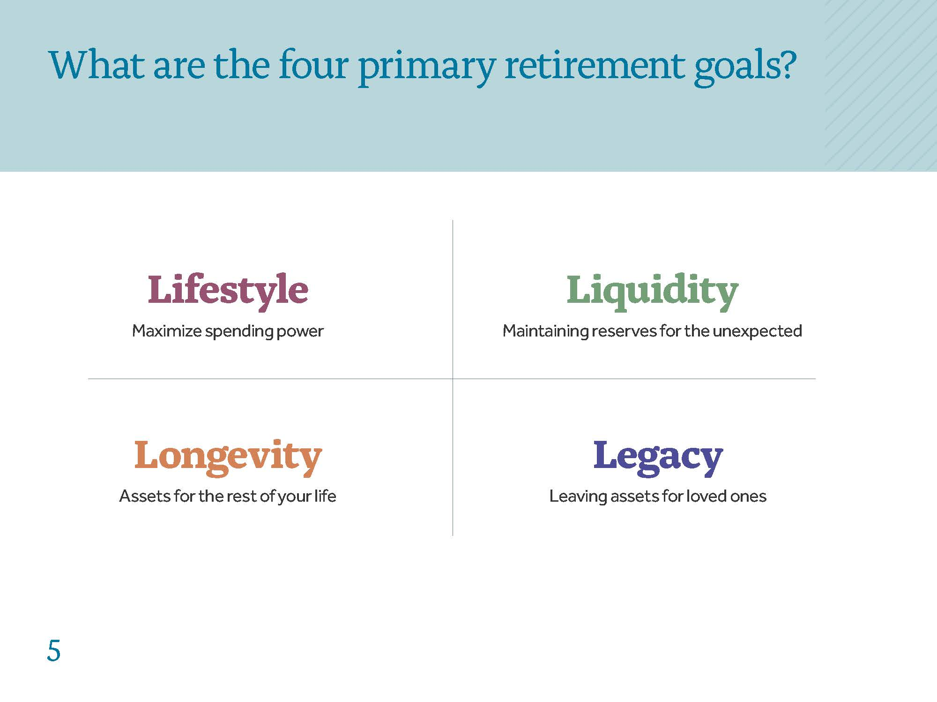
Primary Goals for Retirement Assets
Notes:
Okay, so now that we know that our assets are going to play a big role in retirement, let’s get more specific: What do we actually need our money to do?
While we all have lots of individual goals for our money, for the most part I can divide them into four primary buckets. I like to call them the “4 L’s” for retirement.
Lifestyle: We want to maximize our spending power and use the assets we have wisely to help us create our desired standard of living.
Longevity: We want to make sure our assets can maintain our desired standard of living for as long as we live.
Liquidity: We want to build up a reserve—a cushion if you will—to help overcome unexpected contingencies that might disrupt our quality of life.
Legacy: We want to leave something behind to enhance the quality of life for future generations.
Does that capture everything as far as you’re concerned? Are there any other major goals you have for retirement?

Slide 27
Top two reasons for leaving money in retirement plans:
1
2
“I don’t need it”
“I don’t want to
pay the taxes”
Notes:
There are many reasons why people leave money in their retirement plans. What do you think the top 2 reasons are?

Slide 28
The “Default” Strategy
Let the assets grow until age 72
Take the Required Minimum Distribution
Leave the balance to heirs
Career
Retirement
Accumulate
Grow
RMD
Legacy
Age 65
Age 72
Age 85
Notes:
Without planning, many people will default to simply leaving their money in their retirement plan until they have to start taking money out.

Slide 29

The Key Issue
How to manage the tax liability for retirement plan assets
The question is not
if but rather
when income taxes will be paid
?
Notes:
The biggest challenge many people have is how to manage the tax liability associated with their tax-deferred qualified retirement plans. We all know that taxes will need to be paid on these accounts. The only question is when.
(Lead into next slide) So, let’s consider the potential impact of income taxes on your assets over time. If a dollar doubled every year, what would its value be in 20 years?

Slide 30
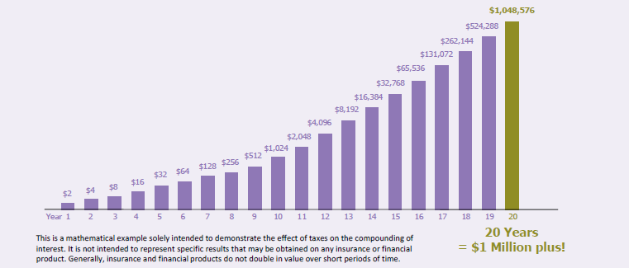
The Impact of Income Taxes
If a dollar doubled every year, what would its value be in 20 years?¹
¹ Please note that although this graphic reflects no taxes during the 20 years of accumulation, in most types of accounts providing for tax deferral, taxes would be due on earnings when there are withdrawals from the accounts. In addition, there may be penalties associated with accounts and financial products that permit tax deferral, including penalties for withdrawals prior to a certain age.
Notes:
Read slide from SMRU 1768809 (Exp. 8.9.2020)
If a dollar doubles every year for 20 years without income taxes, it will grow to over $1.0M dollars.
(Lead into next slide) So now, let’s look at what would happen if a dollar doubled every year but was subject to a 24% tax. Then,
what would its value be in 20 years?

Slide 31
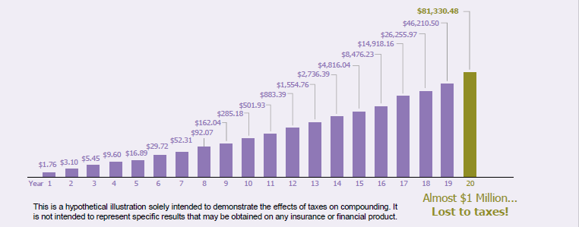
The Impact of Income Taxes
If a dollar doubled every year but was subject to a 24% tax,
what would its value be in 20 years?²
² This illustration assumes that income taxes are paid each year at a rate of 24% on the gain. Neither New York Life Insurance Company nor its agents provide tax, legal, or accounting advice. Please consult your own tax, legal, or accounting professional before making any decisions.
Notes:
Read slide from SMRU 1768809 (Exp. 8.9.2020)
If that same dollar doubles every year but you have to pay income tax on it every year it only grows to a little over $81,000. That is a
$1.0M difference.

Slide 32
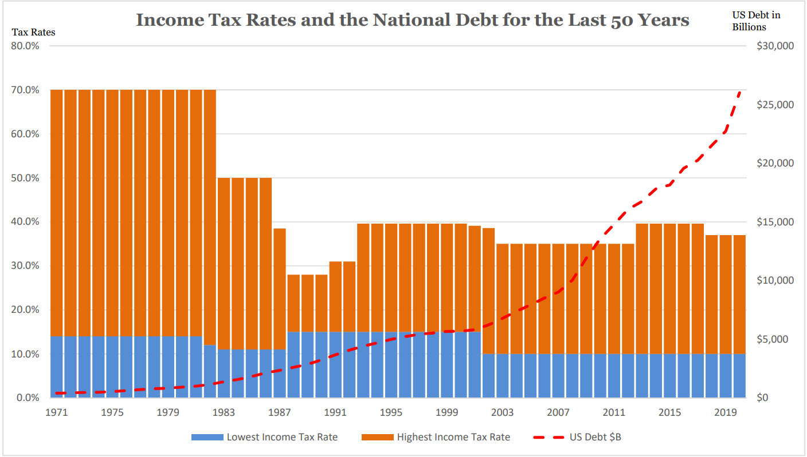
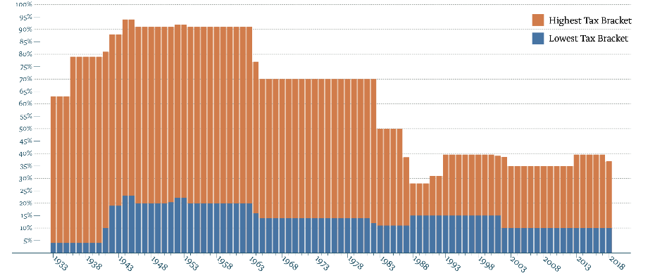
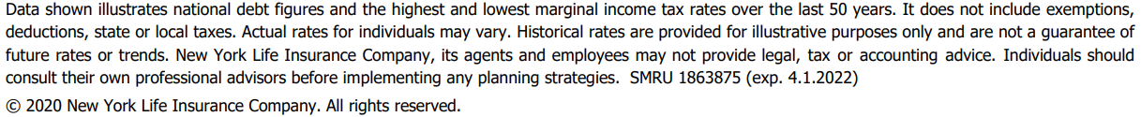
Where do you think tax rates are going?
Source: https://www.taxpolicycenter.org/statistics/historical-highest-marginal-income-tax-rates
https://www.taxpolicycenter.org/statistics/historical-individual-income-tax-parameters
Notes:
If you are a baby boomer or even Gen X, since the time you entered the workforce you were told or encouraged to put money in tax deferred retirement accounts. For a long time, this made a lot of sense. The conventional wisdom was that you would be in a lower tax bracket in retirement so it would make sense to defer income while you were in a high tax bracket so that it could be paid out when you were in a lower bracket. https://www.taxpolicycenter.org/statistics/historical-individual-income-tax-parameters
But, as you can see we have been enjoying fairly low taxes since the late ‘80s.
Where do you think income tax rates will be in the future?
Lower or higher than they are today?
* Note to Speakers – the blue line represents today’s top tax rate of 37%
FOOTNOTE:
This graph illustrates the high and low marginal tax rates over history. Exemptions, deductions, and state and local taxes are not taken into account when illustrating these marginal tax rates. Your actual tax rates may vary from those shown on the graph. Remember that historical rates are not a guarantee of future rates.

Slide 33
Tax of IRA Dollar at Time of Death
$1.00 IRA Dollar
– 0.40 Estate Tax
0.60 Estate After Tax
– 0.21 Income Tax
$0.39 Net to Heirs
* Assumes 40% estate tax and 35% income tax to beneficiary. This example is an approximation for illustrative purposes only.
Notes:
First, keep in mind that no estate tax occurs at death if the qualified plan is left to a spouse. So, what this chart shows is the potential tax treatment at the death of a second spouse or where the qualified plan is left to children or other non-spouse beneficiaries.
If we assume an estate tax of 40% on every $1.00 dollar in a qualified plan over the estate tax exemption amount, only 60 cents would remain after the payment of estate taxes. However, the heirs (children in our example) will not get 60 cents. When the IRA owner dies, the income tax liability of the IRA or other qualified asset is passed to the beneficiaries along with the plan assets. and they are now responsible for paying income tax on the distributions as they receive. The income which accrued prior to the owner's death during the tax-deferred accumulation stage -- that is now taxed to the beneficiaries -- is called Income in Respect of a Decedent (IRD).
So, after the entire value of the asset is included in the taxable estate (40% in our example), the beneficiaries also pay income taxes (35% in our example) when the funds are distributed. In other words, if the beneficiary is in a 35% income tax bracket, the 60 cents left after estate taxes will be reduced by another 21 cents, leaving 39 cents out of each dollar for the children and 61 cents out of each dollar for Uncle Sam.
Of course, in more modest estates, there may be no estate tax, and it is possible the children could be in a lower income tax bracket than the 35% in our example. The purpose of the chart is to make you aware of the heavy tax burden which could attach to qualified assets.

Slide 34

2018 Tax Cuts and Jobs Act
Major provisions “sunset” Dec. 31, 2025
Individual Tax Brackets Revert to 2017 Brackets
Estate, Gift, & GST Exemptions return to 2017 levels
Notes:
What does this mean? Most individuals will find themselves in a higher tax bracket and more people will find that they have enough wealth to have an estate tax problem. And this can impact the amount of your qualified retirement assets that ultimately pass to your children and grandchildren.

Slide 35
What happens when clients leave their IRA to their children?
IRA Owner
$500,000
Child
$350,000
Grandchildren
Notes:
To bring the story to life, in a typical example of a client that dies while owning a $500,000 IRA, their children could pay 30% in taxes, totaling $150,000, leaving $350,000 to their kids.
Income taxes are due on the IRA amounts received by the child. If the child is in his/her 50’s or 60’s at the IRA owner’s death, he or she may potentially be earning his or her highest career income. The addition of IRA inheritance to a child’s existing taxable income could also push the child into a higher tax bracket – meaning the child may pay taxes on the mandatory IRA distributions at a high income tax rate.
In most instances, the child must completely distribute the entire IRA within 10 years of the parent participant’s death. Typically the money will be spent before the child dies, leaving nothing for the grandchildren.
When does it make sense for a client to leave their IRA or qualified plan to their children? (Audience Question) The goal is to have them understand when LIFRA may not be the right solution.

Slide 36




Tax Saving Alternative Using Life Insurance
IRA Distribution
less Tax
IRA
ILIT Funded With CWL
Estate
Notes:
The solution -- of course – will depend on your individual retirement goals and overall estate objectives. If you feel your retirement plan assets will never be needed for your retirement, and your objective is to pass on as much as possible to your children (and other heirs), you might simply take RMDs and reposition the distribution in such a way as to maximize what is left for your heirs.
One possibility would be to either take your RMDs or take distributions from the plan beginning after age of 59½, pay the income tax due, then use these funds to make gifts to an irrevocable trust. The trust assets would be used to purchase life insurance that would be outside of the estate, and thus eliminate future estate taxation on these assets. And if the client is over age 72 and subject to RMDs they don’t otherwise need, this strategy provides a great way to increase their legacy to their children or grandchildren while still maintaining the ability to access the life insurance cash values during retirement if needed.

Slide 37

Case Study
Craig (72) & Clara (66)
Married with 3 children
Own IRAs of $500,000 earning 5%
Combined State and Federal Income tax rate 30%
Have taken no distributions
Adequate income from pensions and social security
Want access to the money for emergencies or healthcare
Hope to leave most of their IRAs to their children
Notes:
Read Slide

Slide 38

How much to distribute annually?
Sweep the Gains
The 10% for 10 Years Option
Required Minimum Distributions
Your Choice for Lifestyle & Legacy Objectives
Notes:
There are many different ways to decide how much you should take out of your qualified retirement plans each year. Here are 4 of the most common.
Lets take a look at what 3 of these options might look like.

Slide 39
Distribution Options
Required Minimum Distribution
2020 RMD:
$19,531
Age 90
Balance:
$422,759
Net After
30% Taxes:
$295,932

Slide 40
Distribution Options
Sweep the Gains
Distributions:
$25,000 for seven years, then RMD
Age 90
Balance:
$405,083
Net After
30% Taxes:
$283,558

Slide 41
Distribution Options
The 10% for 10 years option
Distributions:
$50,000
then RMD
Age 90
Balance:
$151,938
Net After
30% Taxes:
$106,356

Slide 42

Create a Tax-advantaged Asset
Distributions can fund a new asset that is beneficial for both your lifetime and ultimately your heirs.
Notes:
There is an alternative to these strategies. You can create a new asset that will benefit both you and your children and grandchildren.

Slide 43

Questions to Consider
If things go the way you have planned, what’s going to happen to your IRA?
  “To my loved ones/my kids...”
Why haven’t you given it to them already?
  “We may need the money…”
Notes:
I want to talk to you about an insurance option that can:
Allow you to keep the assets distributed from your IRA in your care, custody, and control for the rest of your life in case you need them.
Potentially double or triple the value of the asset for your beneficiaries

Slide 44
Strategy
Tax-free cash value is available during your lifetime for gifts, emergencies, or healthcare costs*
Tax-free death benefit will be paid to your children as beneficiaries
Begin distributions to take advantage of current tax rates
Use distributions to fund a cash-value life insurance policy
*Policy loans accrue interest at the current rate, and any withdrawals or loans will reduce the death benefit and cash value.
Notes:
Take distributions from your qualified plan to take advantage of the current low income tax rate environment. Use that money to fund a cash value life insurance policy. If you own it personally, you will have access to the cash value during your life and a tax-free death benefit will be paid to whomever you designate as your beneficiary.

Slide 45
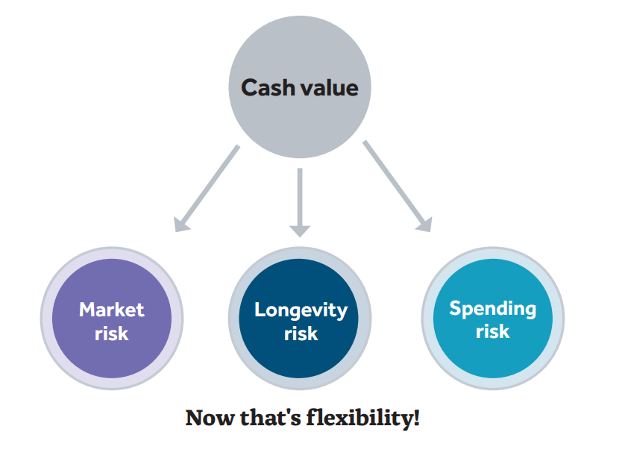
Use cash value to manage retirement risks*
Cash Value
Market
Risk
Longevity Risk
Spending Risk
Now That’s Flexibility!
*Policy loans accrue interest at the current rate, and any withdrawals or loans will reduce the death benefit and cash value.
Notes:
What’s great about whole life insurance is that it not only gives you more flexibility, it gives you more freedom. Here’s what I mean:
Since you have the cash value in your policy to fall back on during hard times, you are free to invest your other assets more aggressively and pursue higher returns.
You may also have the freedom to withdraw a higher percentage of your retirement assets than might otherwise be the case. While a common rule of thumb says 4% is a relatively safe amount, you may be able to withdraw even more—possibly 6-7%— if you know that you have your policy’s cash value as an additional resource. Think about the difference that could make in your lifestyle.
Perhaps most importantly, having a whole life policy gives you the freedom to enjoy your money. Want to go on a cruise, travel the world, or simply spend more time visiting the grandkids? Since you know that your policy comes with a guaranteed death benefit—money that will be passed along to your loved ones when you pass away—you don’t have to worry about setting other money aside for their inheritance. And, if you find that you no longer need the full death benefit—you can use the cash value toward doing all the things you said you’d do if you ever had the time. How does that sound?
Okay, so that was a pretty deep dive into the ways that whole life can help protect you against market risk. But what about the other two: longevity risk and spending shocks? While I won’t go into as much detail, I think you can see how the cash value can be used to mitigate those risks as well.
Longevity risk – If you are worried about running out of money in retirement, you can use the cash value as a supplemental source of income. This will reduce the death benefit and cash value of the policy, but that may be a trade-off your willing to take at that time.
As we mentioned above, it may also allow you to use your other assets more aggressively which in turn, could make them last even longer. What’s more, there are no Required Minimum Distributions (RMDs) associated with the cash value in a life insurance policy—so you can let your money grow tax-deferred for as long as you own the policy.
Spending shocks – If you are suddenly hit with an unexpected expense, you may be able to use the cash value of your policy to pay for it. That way your monthly budget could remain intact, and you wouldn’t have to possibly sell other income generating assets to cover the cost.

Slide 46
Use the death benefit to provide a legacy
Death
Benefit
Tax Free Money to Children
Replace SS Benefits for Spouse
Charitable Donations
Creating more leverage
Notes:
A whole life insurance policy can help you and your loved ones a whole lot of ways. That’s because it provides a lifetime of protection and value, and gives you the flexibility it needs to prepare for the future.
The death benefit is guaranteed and passes to your beneficiaries generally income tax-free. This money can also be used to replace social security benefit for your spouse and could even be used to make charitable donations to create a different kind of legacy.

Slide 47

Conclusion
IRAs are designed for retirement savings
IRAs can lose much of their value at death to income and estate taxes
Life insurance can help protect those assets
Notes:
By offering tax-deferred growth during their accumulation period, IRAs are primarily designed as retirement savings vehicles. Most IRA owners will use an IRA to supplement their retirement income, but some clients don’t need any income from their IRAs and are planning to pass them on to loved ones. Some of these clients don’t realize that at the death of an IRA owner, particularly when there is no spousal beneficiary, the IRA may lose much of its value to possible estate and income taxes. For these clients, withdrawals from the IRA, often mandated as required minimum distributions, can be used to fund a life insurance policy. The life insurance policy can be structured, with proper planning, outside of the insured’s estate, while still being available to provide estate liquidity for income and estate taxes, as well as final expenses. With an aging affluent population, financial professionals have a great opportunity to offer suggestions on how life insurance can enhance an estate legacy for an IRA owner who does not need income from his or her IRA.

Slide 48
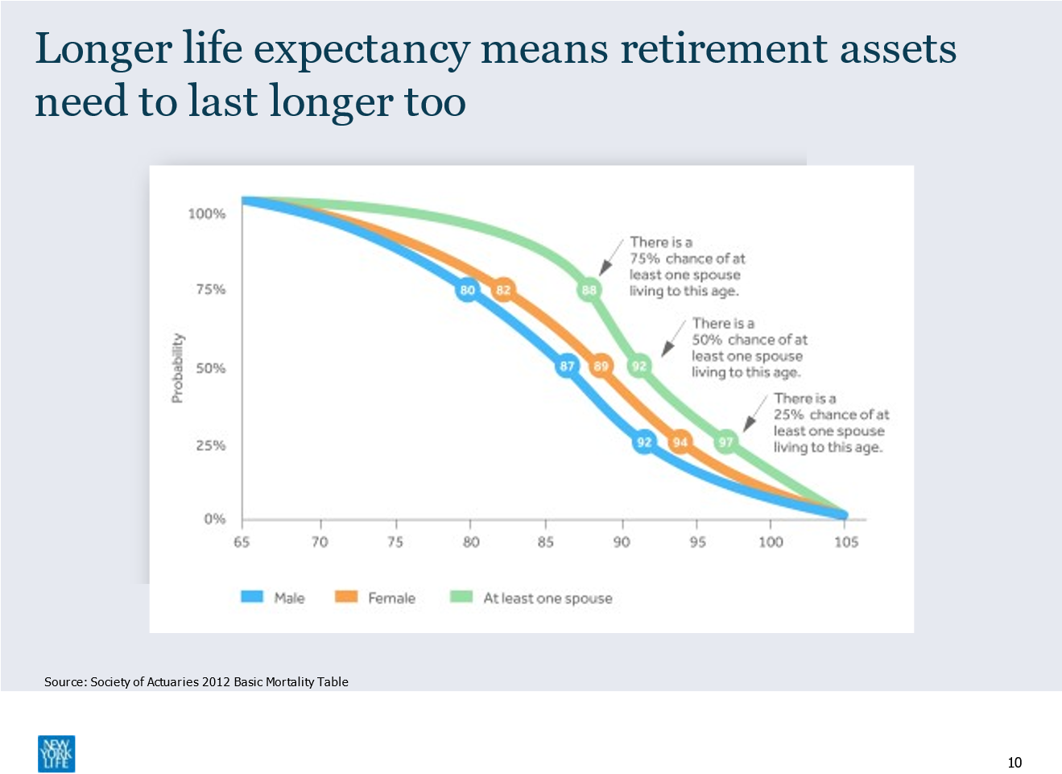

Slide 49
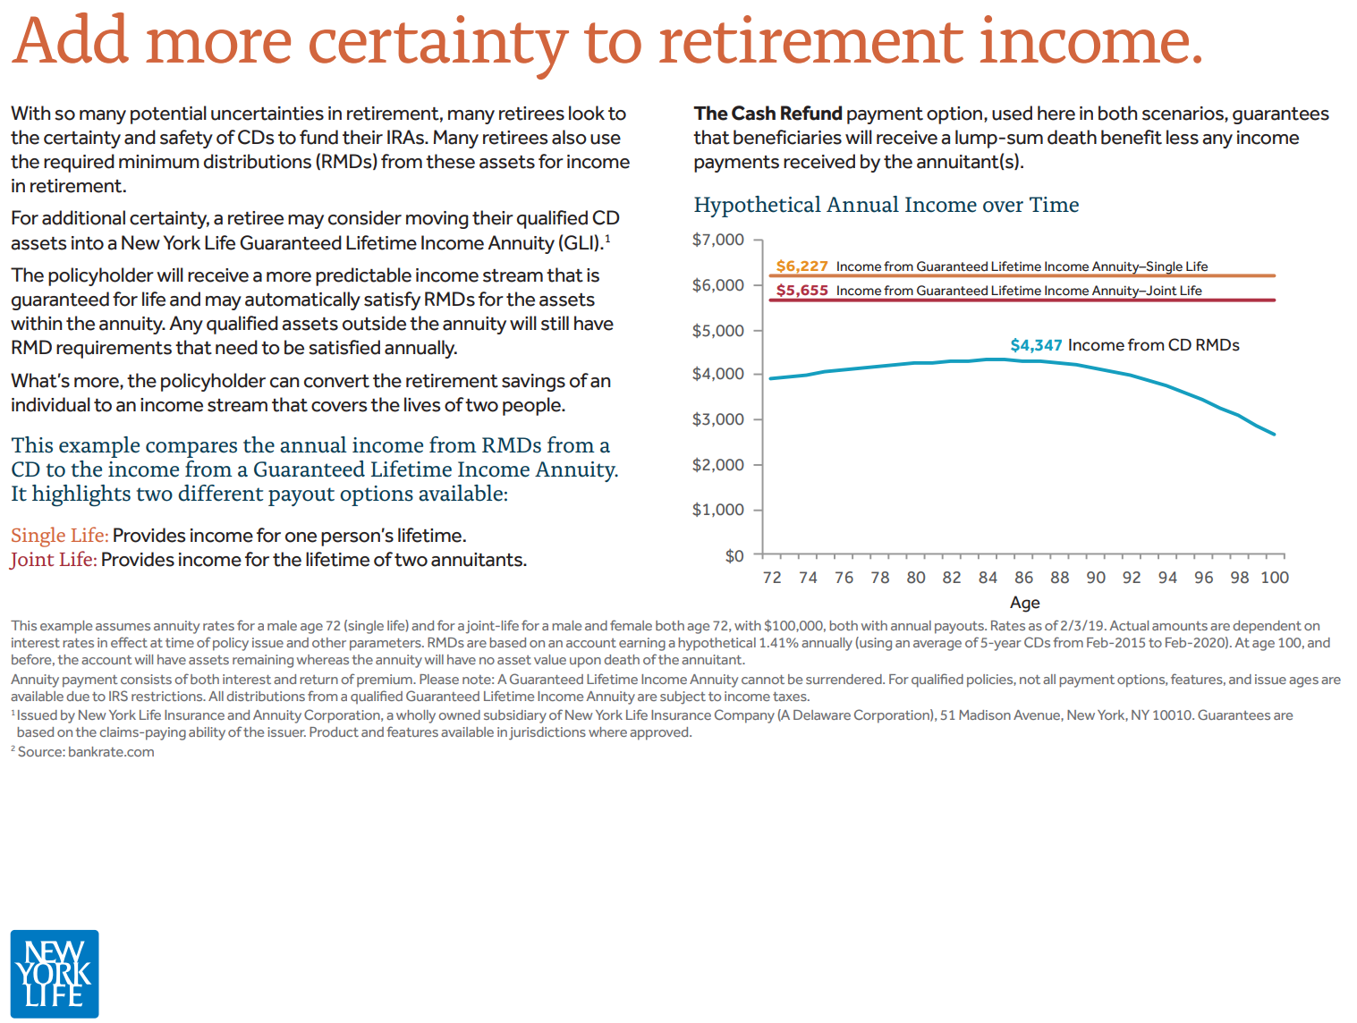

Slide 50
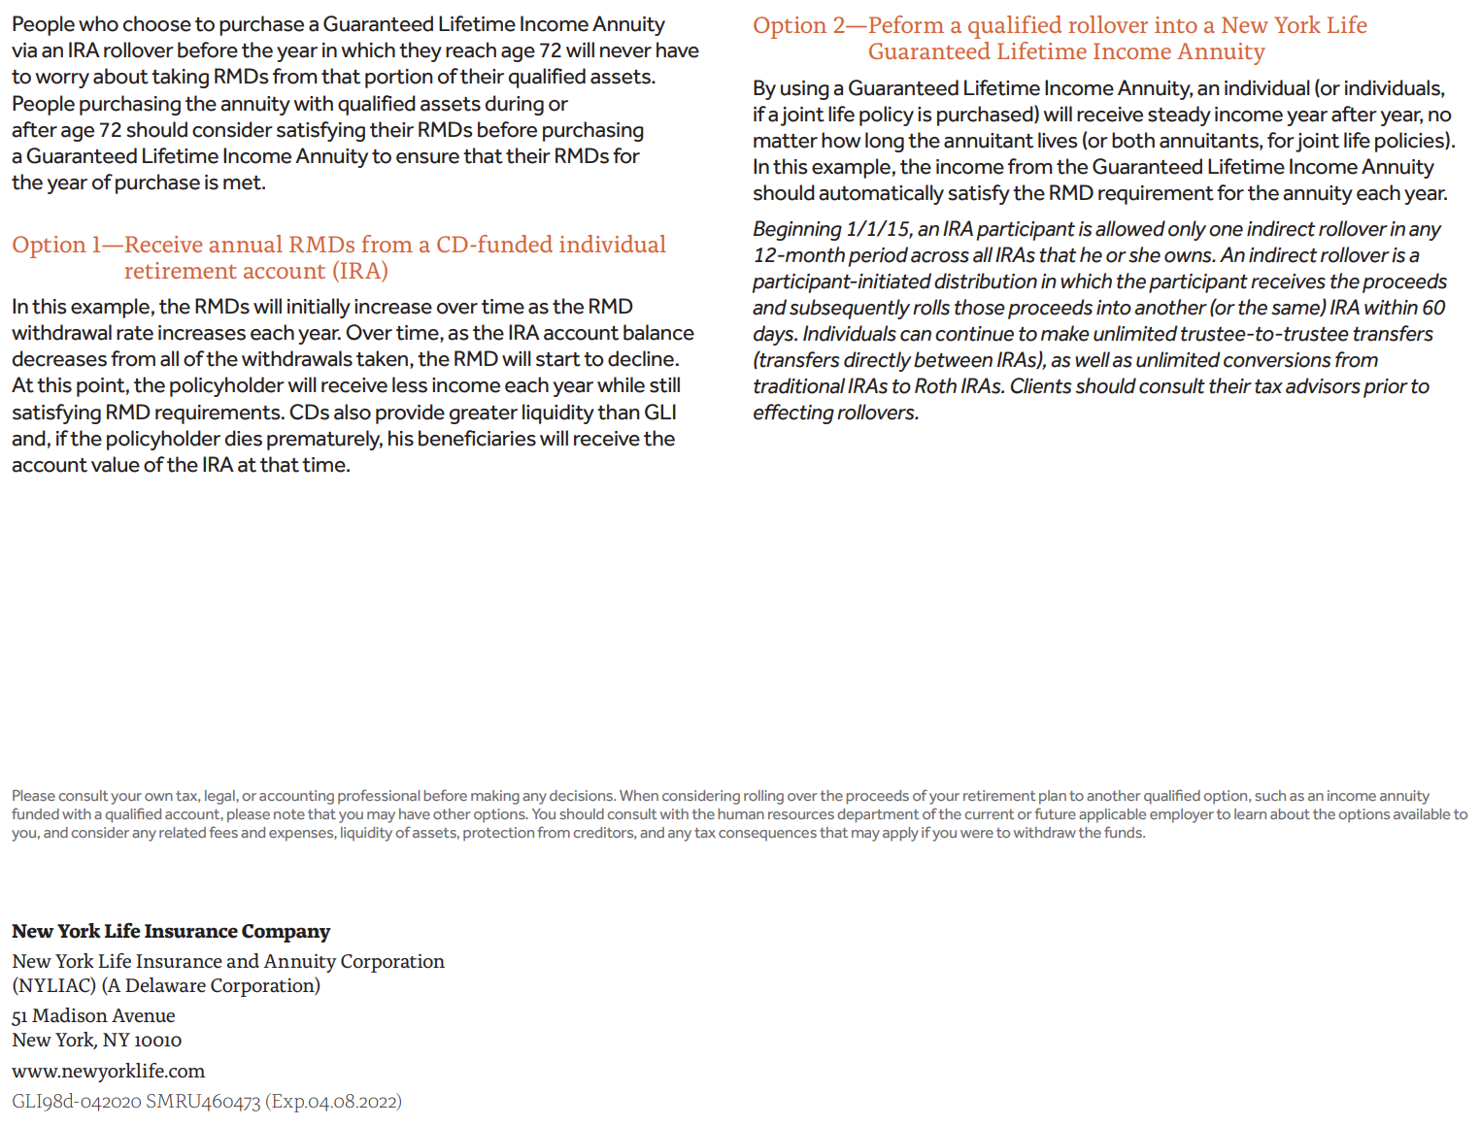

Slide 51

Questions
www.nyladvisors.com

